Slide 1


Slide 2
Azure Logic Apps
Automate
Tasks and
Workflows
Integrate
Apps, systems, data, and services across organizations.
Provides visual designer
For configuring the workflows
Can define a workflow
With connectors and logic creation using inbuilt standard connectors
No worry
About hosting, scalability, availability and management
Scales up
Automatically to manage demand.
Company can run smarter than previously

Slide 3
Examples
Send email notification
When something happens in your system, app or services
Move Files
To Azure storage from SFTP or FTP servers
Monitor the tweets
Perform sentiment analysis on them
Create alert for the tweet which needs to be reviewed
Change the logic in app
Just with some toggles of the switch
No deployment of your entire codebase needed

Slide 4
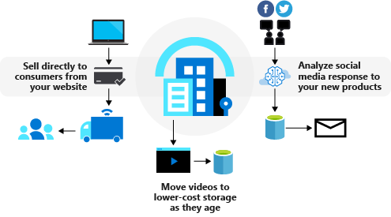
Azure Logic Apps
Implementing a business process can be challenging because we need to make diverse services work together
Think about everything your company uses to store and process data:
Salesforce
Microsoft 365
Oracle
Twitter
YouTube
Dropbox
Google services, Azure Cognitive Services, and so on
How do you integrate all these products?
Azure Logic Apps gives you pre-built components to connect to hundreds of services

Slide 5
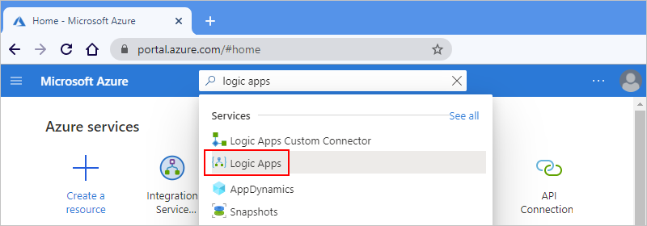
Create your logic app
Under Templates, select Blank Logic App.

Slide 6
Hands-On: Create a simple Logic App

Slide 7
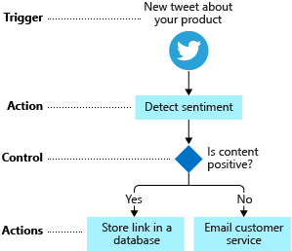
What are triggers and actions?
Workflows are built from different types of tasks.
For example, in our social-media monitor scenario we start the workflow:
When a new tweet is posted
Perform work like detect the sentiment and
Make a decision based on the sentiment score

Slide 8
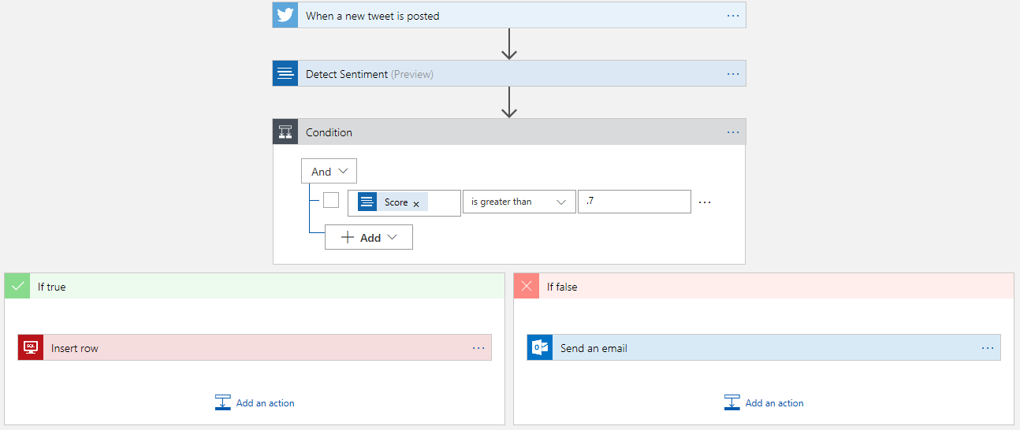
What is the Logic Apps Designer?

Slide 9
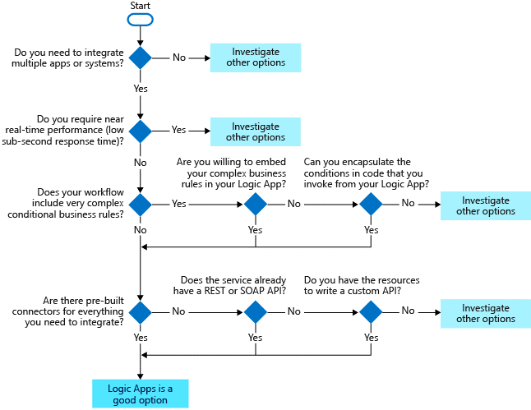
When to use Logic Apps?

Slide 10
Hands-On
Review different features of Logic App
Condition Control
atinlogicapp2
Loop Control
atinlogappsForEach
Branches
atinLogicAppsBranching
Variables
atinLogicAppsBranching

Slide 11
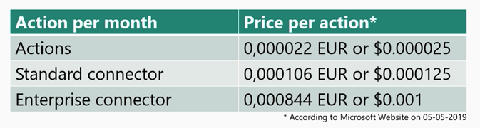
Pricing of Azure Logic Apps
Pay-as-you-go model
For instance, if you process 1000 service bus messages a day, with a workflow of five actions it would cost you EUR 4.62 approx.
To execute a normal action, it would cost $ 0.000025 and for a Standard connector, it would cost you $0.000125
Even, the Enterprise connector would cost you only $0.001

Slide 12


